Slide 1
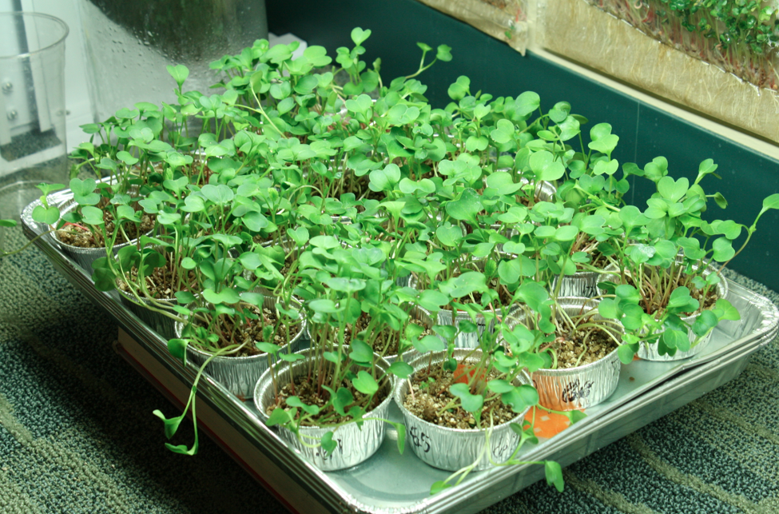
Lesson 2
Harvesting Our Plants

Slide 2
What happens when plants gain mass?
Where are atoms moving from?
Where are atoms moving to?
Chemical change
What molecules are carbon atoms in before the change?
What other molecules are involved?
What molecules are carbon atoms in after the change?
What other molecules are produced?
What forms of energy are in the reactants?
What forms of energy are in the products?
Remember: Atoms last forever (so you can rearrange atoms into new molecules, but can’t add or subtract atoms)
Energy lasts forever (so you can change forms of energy, but energy units can’t appear or go away)
Notes:
Before harvest begins, revisit your initial ideas about what would happen to the plants as they grow from the Pre-Lesson. These ideas may be on the wall or in a ppt.

Slide 3
Harvest
Follow steps on your Harvest Checklist to collect data and record results.

Slide 4
Class Data for Plant Growth Investigation (Pre-Lesson and Lesson 1)
Group | Vermiculite Start Mass | Vermiculite End Mass | Vermiculite Mass Change | Plant Start Mass | Plant End Mass | Plant Mass Change | Total Change in Mass
1
2
3
4
5
6
7
Average
Notes:
Recall your initial data (this may be in a ppt, and it may be in on a poster, and it may be in PlantsClassResults.xlsx)

Slide 5
Put this data into the graph in PlantsClassResults.xlsx. What do you see?
Notes:
Ideally, students will recognize that

Slide 6
Explaining your Results
What are your observations of mass change in the plant? (what happened?)
What are our conclusions based on these observations? (why did this happen?)
Notes:
Answer these questions as a class. Alternatively, you can write these results on the class poster in PlantsPosters.pptx or in PlantsClassResults.xlsx.

Slide 7
Three Questions Poster
Question | Rules to Follow | Evidence to Look For
The Movement Question: Where are atoms moving? Where are atoms moving from? Where are atoms going to? | Atoms last forever in combustion and living systems All materials (solids, liquids, and gases) are made of atoms | When materials change mass, atoms are moving When materials move, atoms are moving
The Carbon Question: What is happening to carbon atoms? What molecules are carbon atoms in before the process? How are the atoms rearranged into new molecules? | Carbon atoms are bound to other atoms in molecules Atoms can be rearranged to make new molecules | The air has carbon atoms in CO₂ Organic materials are made of molecules with carbon atoms Foods Fuels Living and dead plants and animals
The Energy Question: What is happening to chemical energy? What forms of energy are involved? How is energy changing from one form to another? | Energy lasts forever in combustion and living systems C-C and C-H bonds have more stored chemical energy than C-O and H-O bonds | We can observe indicators of different forms of energy Organic materials with chemical energy Light Heat energy Motion
Notes:
Remind students that their explanations should stick to the rules!

Slide 8
Plant Growth Investigation Sample Data
Trial # | initial mass of vermiculite (g) | initial mass of seeds(g) | final dry mass of vermiculite (g) | final dry mass of plants (g) | change in mass of vermiculite (g) | change in mass of plant material (g)
1 | 32.44 | 0.07 | 32.3 | 0.90 | -0.14 | 0.83
2 | 33.63 | 0.06 | 33.3 | 1.10 | -0.33 | 1.04
3 | 32.78 | 0.06 | 32.6 | 1.20 | -0.18 | 1.14
4 | 32.51 | 0.05 | 32.3 | 1.10 | -0.21 | 1.05
5 | 33.14 | 0.06 | 32.6 | 1.60 | -0.54 | 1.54
6 | 32.13 | 0.05 | 32 | 0.80 | -0.13 | 0.75
Average |  |  |  |  | -0.26 | 1.06
Notes:
If your results were poor for some reason (plants didn’t dry completely, spilled vermiculite, etc) you can use this

Slide 9
Sample Data
Notes:
Sample data graph for discussion.

Slide 10
What new ideas do you have about what happens when plants gain mass?
Where are atoms moving from?
Where are atoms moving to?
Chemical change
What molecules are carbon atoms in before the change?
What other molecules are involved?
What molecules are carbon atoms in after the change?
What other molecules are produced?
What forms of energy are in the reactants?
What forms of energy are in the products?
Remember: Atoms last forever (so you can rearrange atoms into new molecules, but can’t add or subtract atoms)
Energy lasts forever (so you can change forms of energy, but energy units can’t appear or go away)
Notes:
Teaser process tool for all investigations except soda water

